Slide 1
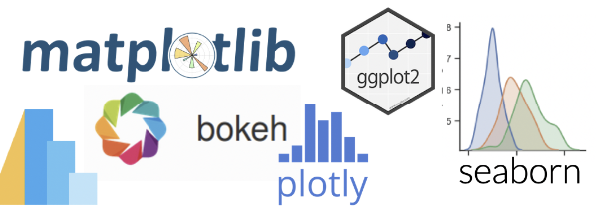
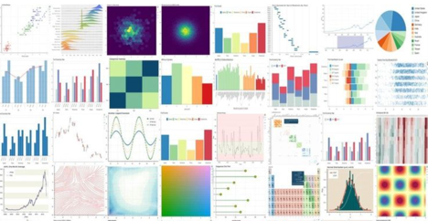

Data Visualization & Business Intelligence with Python
Making data more understandable
Muhammad Adeel Sultan Khan
Data Scientist Agtech, Silicon Valley, California​
Notes:
Main Cover Slide Example. If a presentation will not be submitted for upload to the platform, providing a cover slide at a minimum is recommended for display throughout the Live Training.

Slide 2

Personal Background
Muhammad Adeel Sultan Khan
Ag tech Data Scientist Silicon Valley tech company over 5 years
Treasury Finance 8 years experience
MSIS Data Science Analytics, Santa Clara University
MBA San Jose State University
CFA Level 1 exam
BCS & MBA MIS, Institute of Business Administration

Slide 3
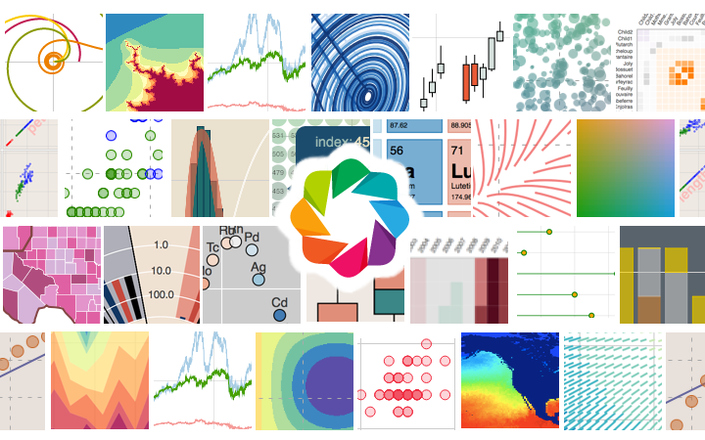
Agenda
Segment 1: Data Visualization Foundations (40 minutes)
What is data visualization
Explore the conceptual and technical fundamentals of data visualization
Why is data visualization important
What are the advantages/disadvantages of data visualization
Why is data visualization important for big data
What are the different types of visualizations
How to create persuasive data visualizations for audience
What is the claim-warrant framework in creating effective visualizations
Segment 2: Introduction to Business Intelligence (40 minutes)
What is business intelligence
How business intelligence works
Different types of BI methods
How BI, data analytics, and business analytics work together
Traditional BI vs. modern BI
What are the benefits of business intelligence
The categories of BI analysis: predictive, descriptive, & prescriptive
Explore BI dashboards and why are they important
Popular BI tools
Data wrangling with Python

Slide 4
Agenda
Segment 3: Data Visualization & Business Intelligence in action (40 minutes)
Data Visualization Redesign – LinkedIn top skills dataset
Deceptive Visualization – Australia’s Gender Pay Gap
Should you be tempted to invest in cryptocurrencies – Using data viz to support the claim
Exercise/Activity Title: Demo of data wrangling and creation of data viz in a jupyter notebook (20 minutes)

Slide 5
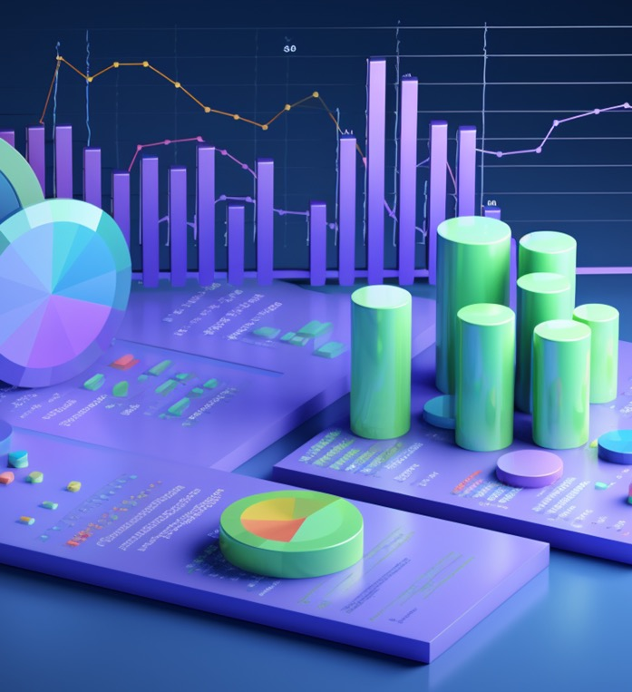
What is Data Visualization
Data visualization is a graphical representation of information & data.
By using visual elements like charts, graphs & maps, data visualization tools provide an accessible way to find trends, outliers, and patterns in data. Visualizations help to present data to non-technical audiences without confusion.
In the world of Big Data, data visualization tools and technologies are essential to analyze massive amounts of information and make data-driven decisions.

Slide 6
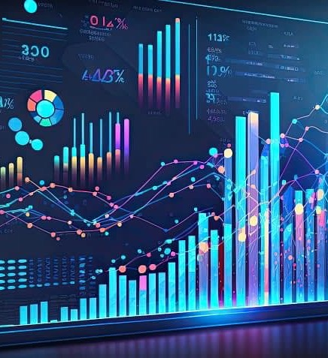
Why data visualization is important
Data Visualization helps people to see and understand data better
An effective visualization brings people on same page regardless of their expertise
Every field government, finance, marketing, healthcare, consumer goods, sports is benefiting from making data more understandable
Data science skills are in high demand & having good data visual skills is imperative
Traditional education draws a distinct line between creative storytelling and technical analysis, the modern professional world also value those who can cross between the two: data visualization sits right in the middle of analysis and visual storytelling

Slide 7
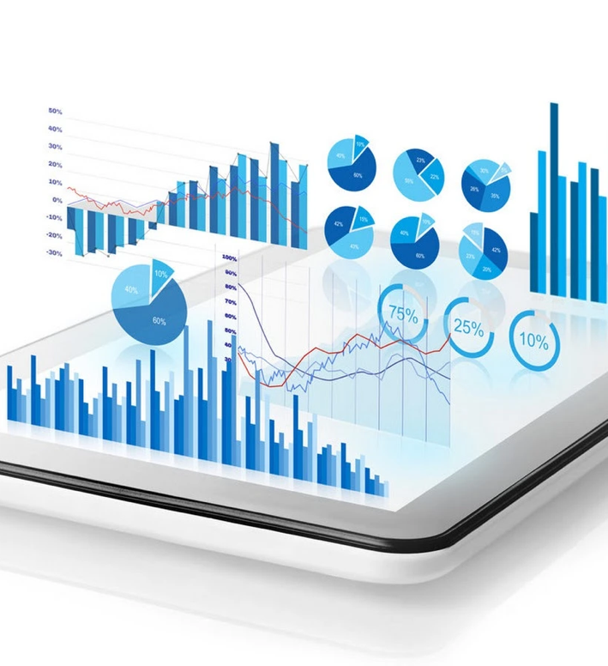
Advantages of data visualization
Data collection rate is increasing exponentially and visualizations help in understanding the data efficiently. Some advantages of data visualization include:
Show trends, patterns & outliers. Display complex relationships
Color patterns differentiates between important attributes
Share information/data easily with the intended audience
Enable teams to take appropriate actions or strategic decision quickly
Unlocking key values for strategic decision making in business

Slide 8

Disadvantages of data visualization
When viewing a visualization with many different datapoints, it’s easy to make an inaccurate assumption. Or sometimes the visualization is just designed wrong so that it’s biased or confusing.
Some other disadvantages include:
Biased or inaccurate information.
Correlation doesn’t always mean causation.
Core messages can get lost in translation.
Data wrangling not done properly could lead to inaccuracy

Slide 9
Poll Question
What are the advantages of data visualization? (Multiple selection)
Show trends, patterns & outliers. Display complex relationships
Share information/data easily with the intended audience
Enable teams to take appropriate actions or strategic decision quickly
Biased or inaccurate information

Slide 10
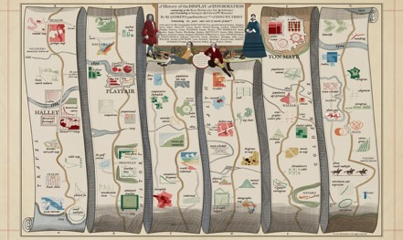
HISTORY OF DATA VISUALIZATION
Charles Joseph Minard: (27 March 1781 – 24 October 1870) was a French civil engineer recognized for his significant contribution in the field of information graphics in civil engineering and statistics. Minard was, among other things, noted for his representation of numerical data on geographic maps especially his flow maps.
Minard's first statistical graphic, from 1825, depicts several time series related to Paris pavement maintenance over the preceding two centuries.
Charles Minard's map of Napoleon's disastrous Russian campaign of 1812. The graphic is notable for its representation in two dimensions of six types of data: the number of Napoleon's troops; distance; temperature; the latitude and longitude; direction of travel; and location relative to specific dates. Statistician professor Edward Tufte described the graphic as what "may well be the best statistical graphic ever drawn".

Slide 11
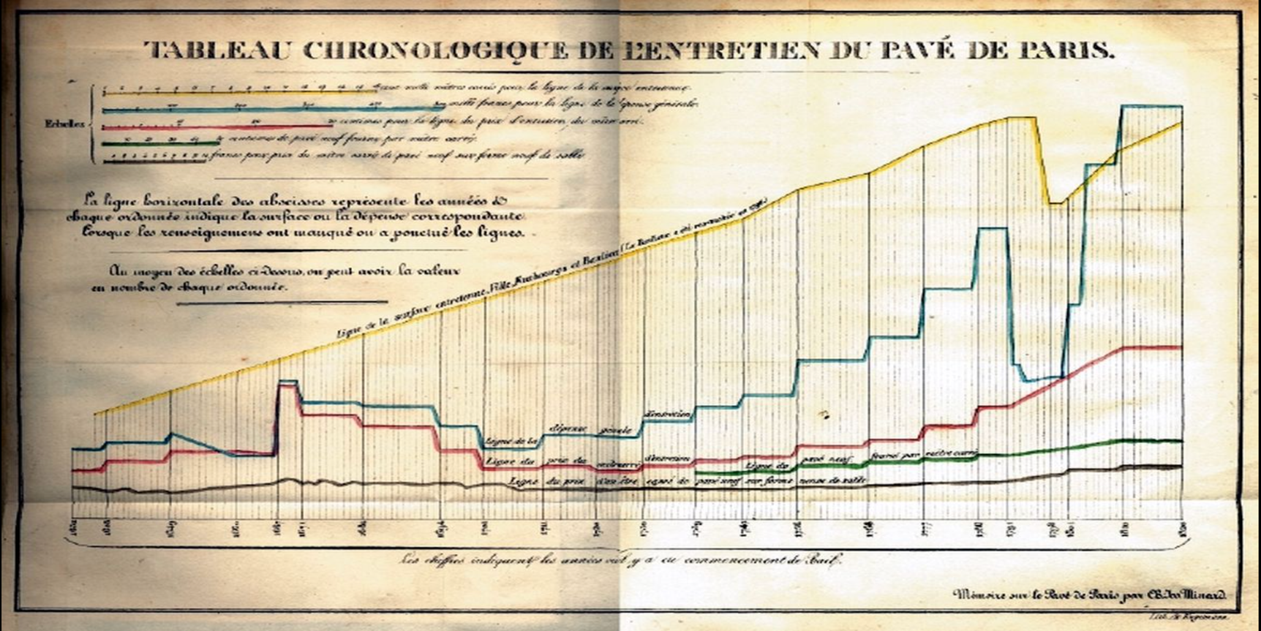
HISTORY OF DATA VISUALIZATION
Notes:
Charles Minard's map of Napoleon's disastrous Russian campaign of 1812. The graphic is notable for its representation in two dimensions of six types of data: the number of Napoleon's troops; distance; temperature; the latitude and longitude; direction of travel; and location relative to specific dates.

Slide 12
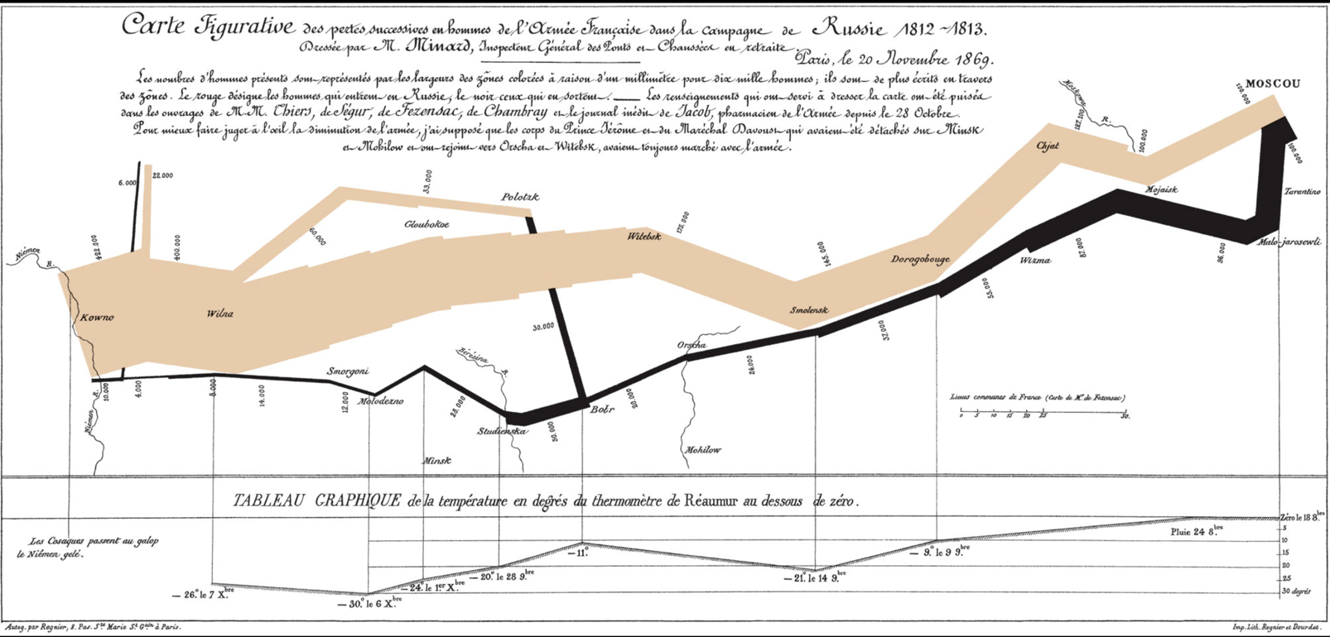
HISTORY OF DATA VISUALIZATION
Notes:
Charles Minard's famous 1869 chart detailing the number of men in Napoleon's Grande Armée during his 1812 invasion of Russia; the tan represents the men who invaded Russia itself, while the black represents the retreat from Moscow. The way that the widths of the colored zones shrink serves as a sobering representation of the staggering numbers of men who were lost in the course of the six-month campaign.
The orange and black columns crossing the map show the French Grande Armée on its march to and from Moscow. The width of the column shows the size of the army – ever-shrinking as thousands of Napoleon’s soldiers died of disease, cold, starvation and Russian attacks. This image brilliantly displays the devastation of Napoleon’s army over the winter of 1812-13. It has been called “the best statistical graph ever drawn”.

Slide 13
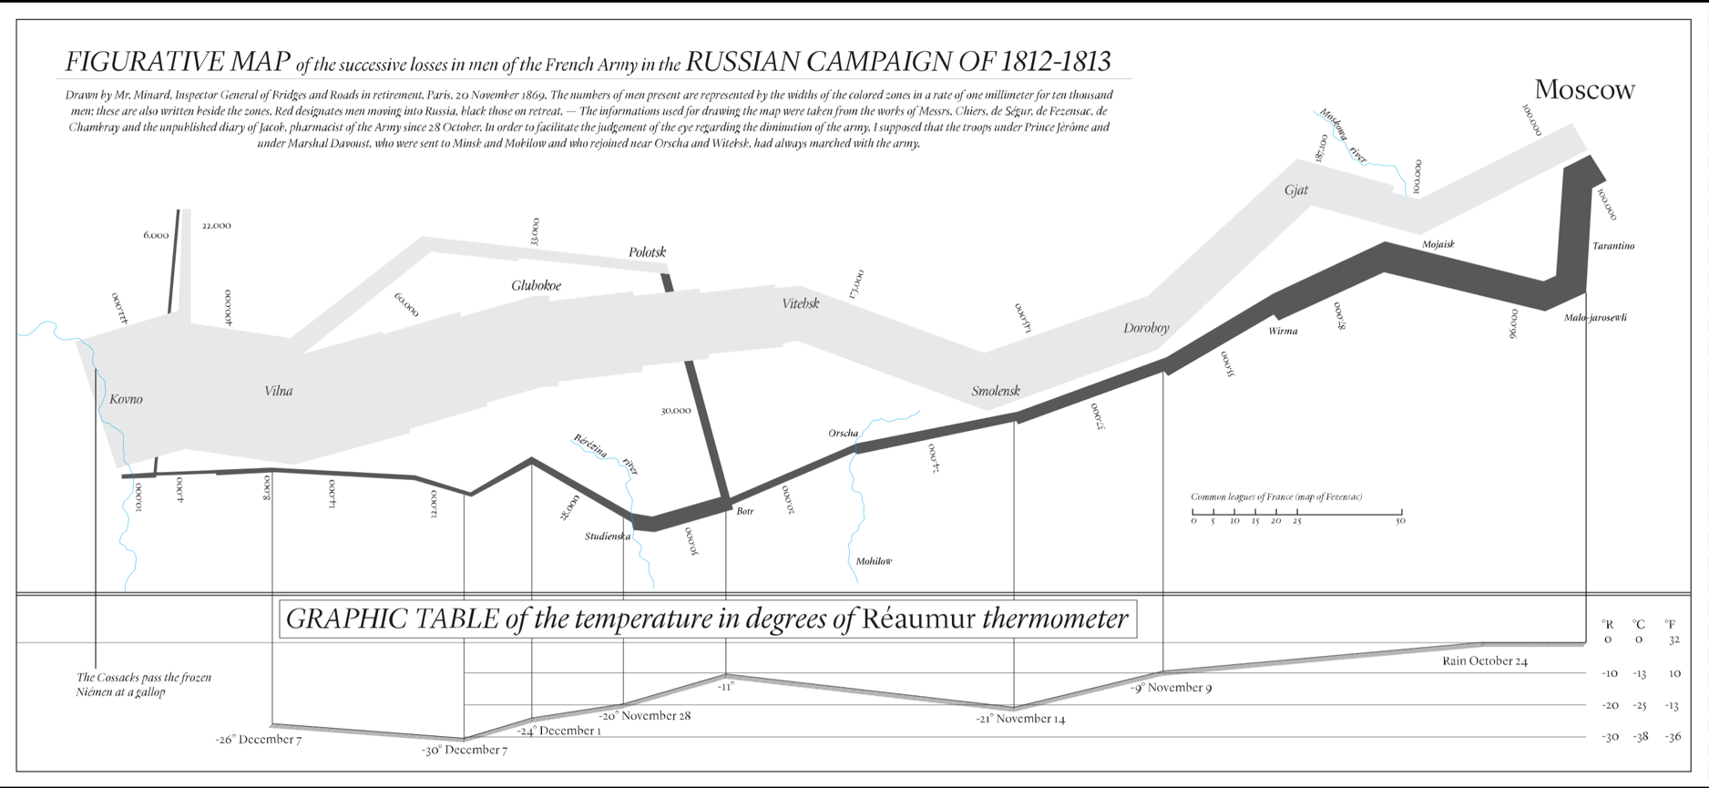
REDRAWING OF CHARLE’S 1812 NAPOLEAN’S CHART
Modern redrawing of Charles Joseph Minard's figurative map of the 1812 French invasion of Russia, including a table of temperatures converting degrees Réaumur to degrees Fahrenheit and Celsius

Slide 14
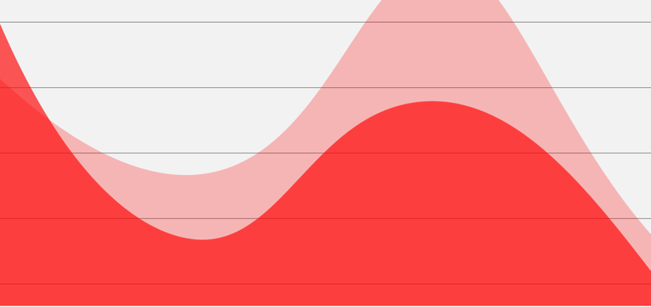
Why Data Visualization
Data visualization can be utilized for a variety of purposes, and it’s not only reserved for use by data teams
Management also leverages it to convey organizational structure and hierarchy while data analysts and data scientists use it to discover and explain patterns and trends
Harvard Business Review categorizes data visualization into 4 key purposes :
Idea Generation
Idea Illustration
Visual Discovery
Everyday dataviz

Slide 15
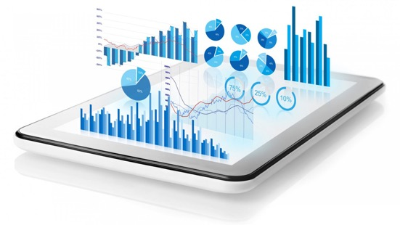
Why Data Visualization
Idea Generation:
Data Visualization is often used to generate ideas in teams using identified trends, patterns and relationship from the visualizations.
Data Visualizations are used in discussion and brainstorming sessions by supporting different perspectives and highlighting the common concerns or viewpoints
Data Visualizations align teams and whole company on common goals and strategic objectives by magnifying the real scenarios in easy to understand terms

Slide 16

Why Data Visualization
Idea Illustration:
Data Visualizations for idea illustration assists in conveying an idea, such as a tactic or process
It is commonly used in learning settings, such as tutorials, certification courses, centers of excellence, but it can also be used to represent organization structures or processes, facilitating communication between the right individuals for specific tasks
Project managers frequently use gantt charts and waterfall charts to illustrate workflows
Data Modeling also uses abstraction to represent and better understand data flow within an enterprise’s information system, making it easier for developers, business analysts, data architects, and others to understand the relationships in a database or data warehouse.

Slide 17

Why Data Visualization
Visual Discovery:
Visual discovery and every day data viz are more closely aligned with data teams. While visual discovery helps data analysts, data scientists, and other data professionals identify patterns and trends within a dataset, every day data viz supports the subsequent storytelling after a new insight has been found.

Slide 18
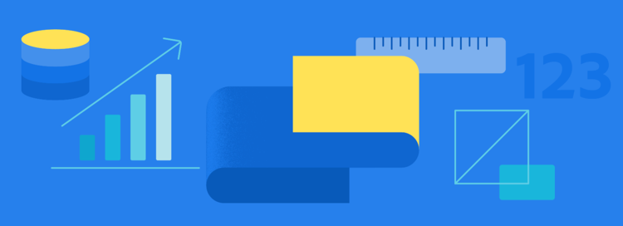
What is data visualization good for
Visualizations are tools that can make complex concepts easier for humans to understand.
In the words of engineer and inventor Douglas Engelbart, “a tool doesn’t just make something easier—it allows for new, previously-impossible ways of thinking, of living, of being.”
The utility of data visualization can be divided into three main goals: to explore, to monitor, and to explain. While some visualizations can span more than one of these, most focus on a single goal.

Slide 19

What is data visualization good for
To Explore:
When users are looking for an open-ended tool that helps them to find patterns and insights in data, a data visualization focused on exploration and fast iteration can help.
Exploration tools should have strong connections to other tools that collect (extract), clean (transform), and curate (load) data.

Slide 20

What is data visualization good for
To Monitor:
When users need to check on the performance of something, a data visualization focused on monitoring is best.
Monitoring tools, such as dashboards, should focus on leading indicators and showing information that is connected to useful and direct actions.

Slide 21

What is data visualization good for
To Explain:
When users want to go beyond the “what” of a problem and dig into the “why,” a data visualization focused on explanation is ideal.
Explanatory visualizations are often hand-crafted to help a broad audience understand a complex subject, and usually are not able to be automated.

Slide 22
Poll Question
The utility of data visualization can be divided into three main goals: to explore, to monitor, and to explain.
True
False

Slide 23

Why use data visualization
According to IBM, 2.5 quintillion bytes of data are created every day. The Research Scientist Andrew McAfee and Professor Erik Brynjolfsson of MIT point out that “more data cross the internet every second than were stored in the entire internet just 20 years ago.”
As the world becomes more connected with increasing number of electronic devices, volume of data will continue to grow exponentially. IDC predicts there will be 175 zettabytes of data by 2025.
Raw data is hard for human brain to comprehend— it’s difficult for human brain to comprehend numbers larger than five without drawing some kind of analogy or abstraction.
Big data is useless without understanding. That’s why data visualization plays an important role in everything from economics to science and technology, to healthcare and human services.
By turning raw data into graphs, content becomes easier to understand and use.
Notes:
International Data Corporation (IDC) is a global provider of market intelligence and advisory services for the information technology, telecommunications, and consumer technology markets. IDC has published several studies that make predictions about data and the IT industry

Slide 24
Data visualization principles
Define a Clear Purpose:
Before creating a data viz, defining a clear purpose will make the process easier and useful and prevent wasting time creating visuals that are not required.
Data visualization helps in strategic decision making and providing answers to hypothesis. It can be used to track performance, monitor customer behavior, and measure effectiveness of processes.
Know the Audience:
Identifying audience before creating data viz is absolute must as it should be compatible with audience expertise and help viewers to view and process data easily and quickly.
Audience preferences guides every decision about visualization – dissemination mode, graph type, formatting & color. Audience intellectual level is an important feature to identify before designing.

Slide 25
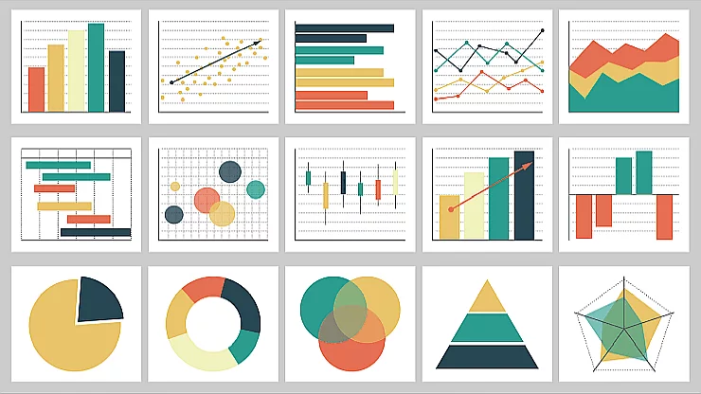
Data visualization principles
Know the Audience:
We should identify what information audience already has and what additional information can our charts provide and focusing mostly on that missing info. to include in the charts
Some chart types are not suitable for a certain group of audience so it ‘s important to match charts with audience needs, requirements and expertise.
Before designing a data visualization, we must answer the following:
Who will be using this data?
What are their objectives?
How will they interact with the data?
What business questions do users need answered?

Slide 26
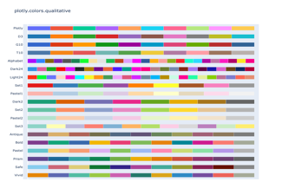
Data visualization principles
Keep it simple:
Simplicity allows us to visually derive conclusions from data more easily. Ineffective visualizations (such as lengthy tables or complex charts) require more conscious thought to analyze information — slowing viewers down and reducing impact.
To quote Stephen Few, one of the founders of modern data visualization, “A picture is worth a thousand words...but only when the story is best told graphically rather than verbally and the picture is well designed.”
Use colors wisely:
Color is a great way to focus your viewer’s attention. However, it’s best not to overwhelm people with too much of it.
When using color in data visualizations, you need to think about both hue (what color something is) and intensity (how saturated the color is.)
You should also keep your use of color consistent. For instance, only use a new color when it relates to a different meaning in the data.

Slide 27
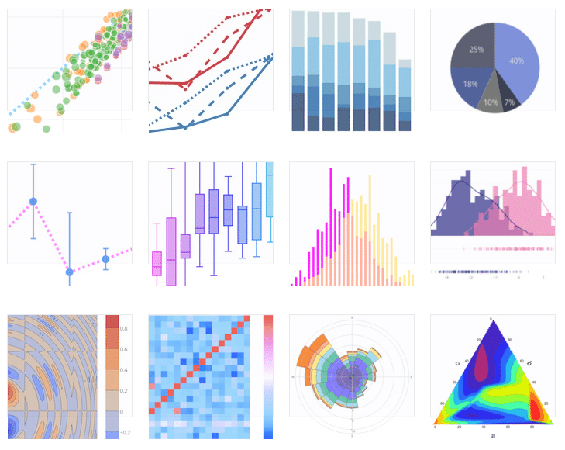
Data visualization principles
Use the right chart type:
The primary purpose of data visualization is to help viewers discover actionable insights. When selecting a chart type, you need to ask yourself:
What story you’re trying to tell
Who your data visualization is for, and what their priorities are
What problem you’re trying to solve
What type of data you have (for instance, do you have categories of data? If so, how many categories?)

Slide 28
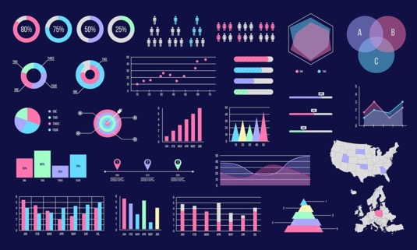
Data visualization principles
Use the right chart type:
Pie charts are best for comparisons between a relatively low number of categories;
Bar charts are best for precise comparisons between categories, and for when you want to show negative and positive values in the dataset;
Scatter charts are great to show correlation and clustering, especially if you have a lot of data
Line charts emphasize trends over time;
Bubble charts showcase distribution or relationships in large data sets;
Area charts let you compare volumes of data easily.

Slide 29
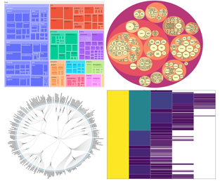
Data visualization principles
Hierarchy:
An important principle in design and specifically data visualization and dashboard design is the concept of hierarchy. There is an expected widget arrangement that users will understand intuitively, without any extra explanation. The right hierarchy is what helps make visualized data and dashboards easily scannable. Hierarchy has a few simple concepts:
The most important information should be located at the top left corner of the dashboard as this is a prime location and it’s the first place that a viewer looks.
Widgets that follow the top-level should explain in more detail why a top-level Key Performance Indicator is what it is.
Text widgets can be used to create titles that can help the content be more clear.
White space is important, too. Sometimes it’s better to leave a gap rather than make something bigger just to fill space.
Visual hierarchy is crucial in data viz as it helps viewers quickly get the important info. organizing information in a logical order and grouping related elements together can contribute to better visual hierarchy.

Slide 30
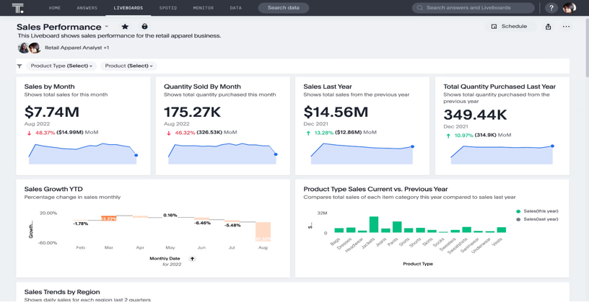
Data visualization principles
Highlight the important information:
Data visualizations tell a story. By highlighting the most crucial information first, viewers can see what the story is all about.
You can also use the position of the data to create emphasis. For Western audiences, the top-left is considered prime real estate.
e.g., total sales by month is likely the most important information for audience, Liveboard show that data in the top-left.

Slide 31
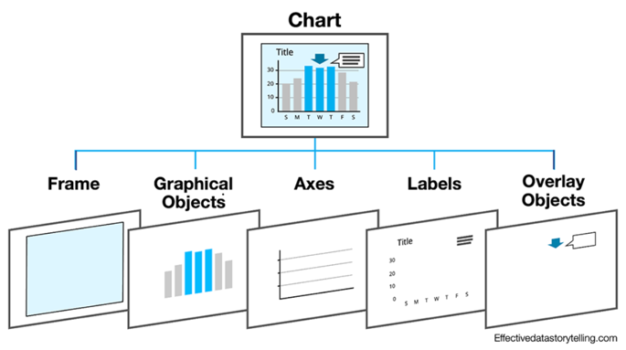
Data visualization principles
Avoid clutter:
If you try to put too much information in the same visualization, the actionable information gets lost in the noise.
Instead, it’s better to encourage the viewer to discover information through progressive disclosure–revealing each piece of information as you go to build a complete picture.
For instance, start by just showing the highest level data in your presentation and progressively drill down into the data to answer questions from your audience
5 categories of clutter:
Frame: The background area of the chart.
Graphical objects: The elements that are used to visualize or display the data values.
Axes: The reference lines along the edges of the frame.
Labels: All text elements that describe the chart’s data values, axes, etc.
Overlay objects: All elements that are overlaid or inserted into the chart for explanatory purposes.

Slide 32
Poll Question
Which chart type shows trends and patterns over time?(single selection)
Bar charts
Scatter plots
Line charts
Pie charts

Slide 33

Data Visualization Approaches & Examples
With dozens of chart types available, each known to suit one particular purpose or another, it is extremely important to choose the right chart type. In fact, picking a wrong form is one of the most common — and critical — visualization mistakes.
Let’s look at seven common examples of data visualization tasks and see what chart types are the best fits.
Compare Data
Explore composition & part-to-whole relationship in data
Track data over time
Analyze data distribution
Evaluate current performance of data
Examine project data
Make sense of geographical data

Slide 34
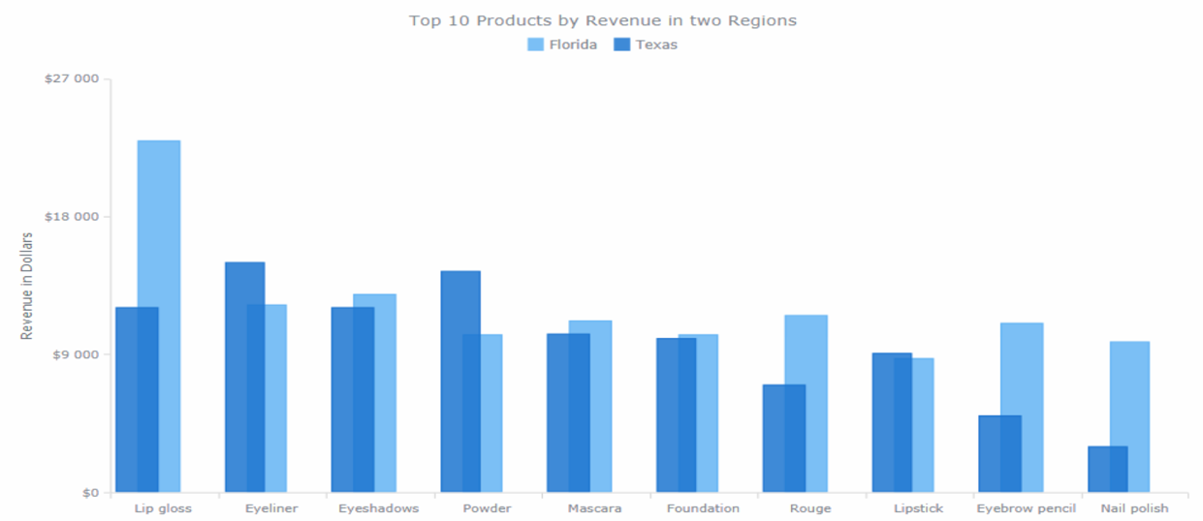
Compare data
To compare data, the following chart types are commonly helpful:
Bar charts (and column charts) — for a straightforward comparison of quantitative values by category.
Stacked charts (and 100% stacked charts) — to add a look at the composition.
Radar charts — for a comparison of cyclic data.
For example, you can use bar charts to visualize products by revenue and referral sources by user traffic; stacked charts — sales figures by product and by region; radar charts — air temperature by month; etc.

Slide 35
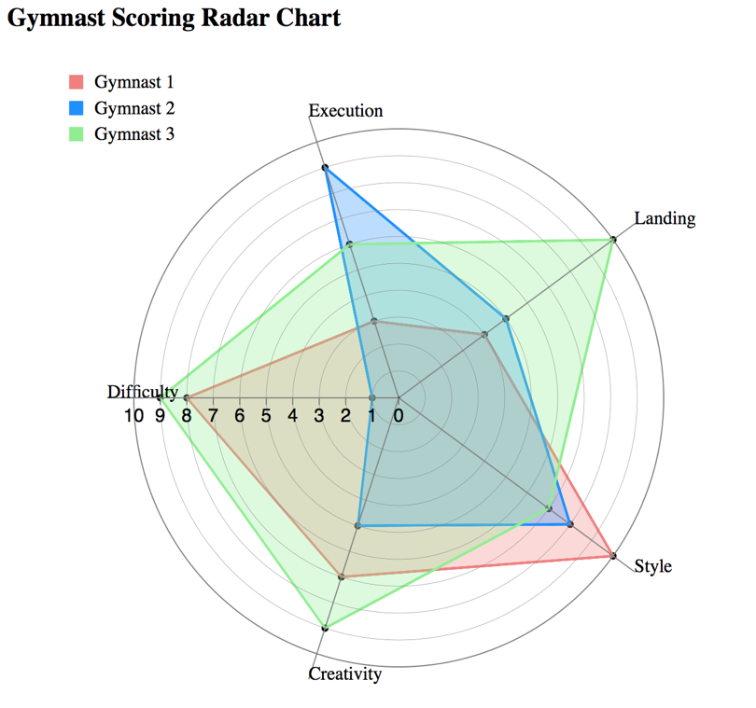
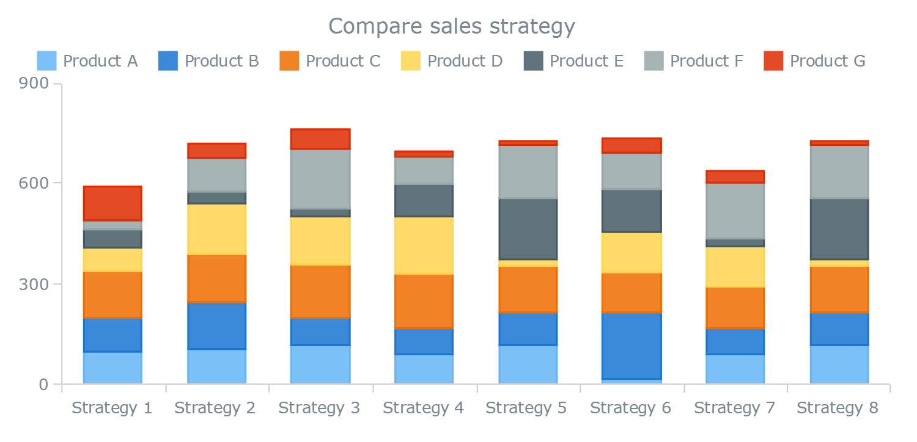
Compare data

Slide 36
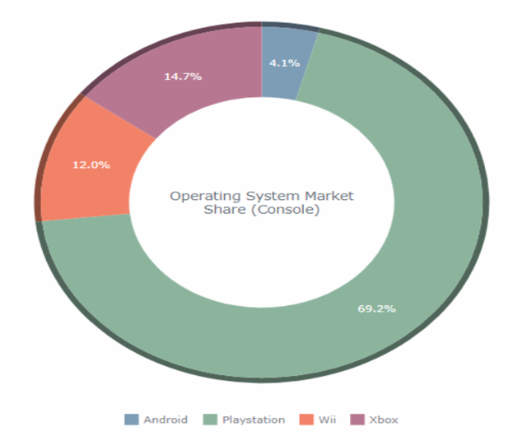
Explore Composition and Part-to-Whole Relationships in Data
To explore the composition and part-to-whole relationships, the following chart types are commonly helpful:
Pie charts (and donut charts) — for a basic look at the percentage composition of a value.
Pyramid charts — to explore the composition of hierarchical data.
Treemap charts — to look into complex hierarchical data.
Funnel charts — to measure stages of processes and discover bottlenecks.
pie or donut charts to visualize a breakdown of the overall sales by retail channel or one of the total website traffic by user age; pyramid charts — OSI model or employee salary by management level; treemap charts — web traffic by source category (and by flow amount) or export directions by country of destination; funnel charts — sales funnels; etc.

Slide 37
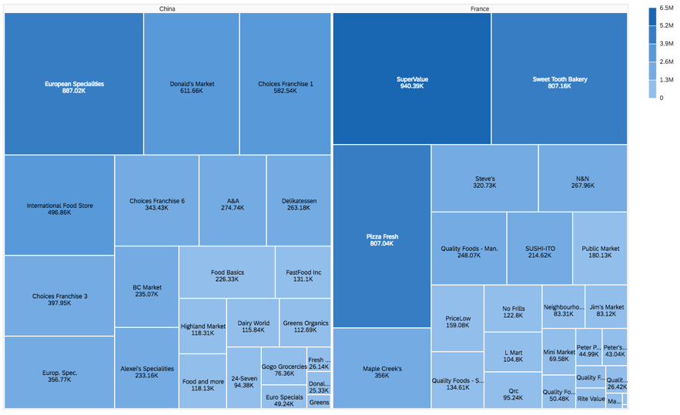
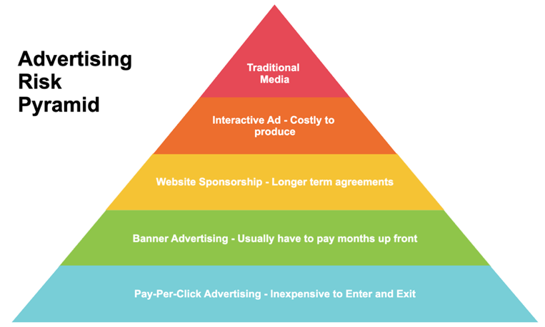
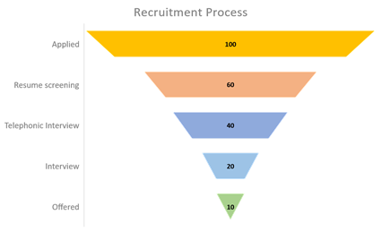
Explore Composition and Part-to-Whole Relationships in Data

Slide 38
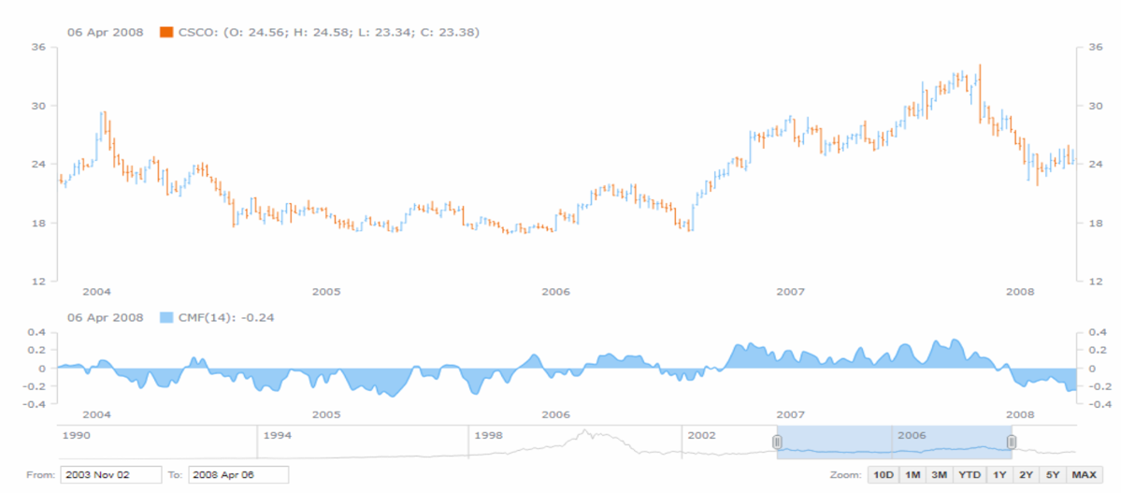
Track Data Over Time
To track data over time, the following chart types are commonly helpful:
Line charts (and spline charts) — for a basic view revealing trends, peaks, and so on.
Area charts — as another option, e.g. for cumulative data.
Stock charts — for big data sets such as financial and stock market data.
Candlestick charts (and OHLC charts) — to add a look at the distribution of values within each period of time.
Sparkline charts — for a quick representation of the big picture, with no axes.
line, spline or area charts to visualize sales or web traffic over time; stock charts — stock price change (also along with technical indicators); OHLC and candlestick charts — stock price with a look into value fluctuation ranges within each of the numerous time periods; sparkline charts — overview of the sales performance within the last 12 months or football season win/loss results; etc.

Slide 39
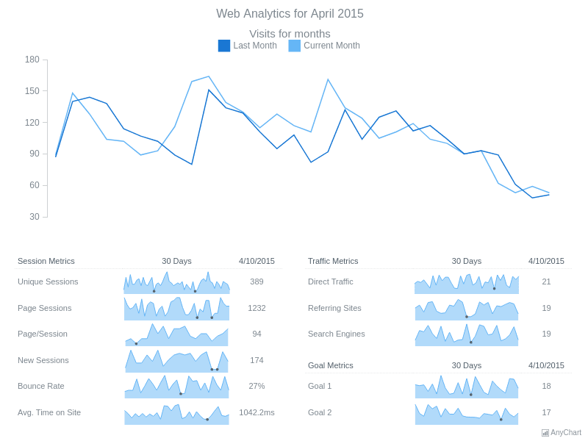
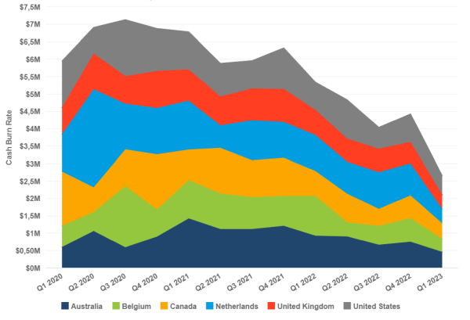
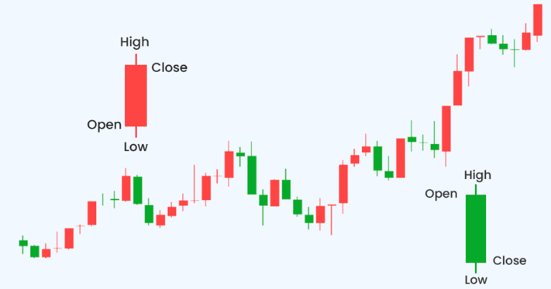
Track Data Over Time
Notes:
Area, sparkline charts, candlestick

Slide 40
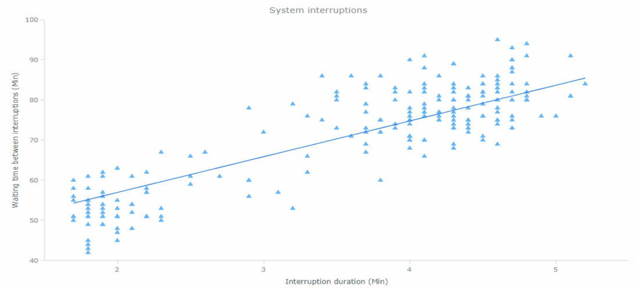
Analyze Data Distribution
To analyze data distribution and relationship between data sets, the following chart types are commonly helpful:
Dot (scatter) charts — to examine trends in distribution and correlation between two variables.
Bubble charts — to consider three dimensions of data.
Box-and-whisker charts — for a look at main distribution ranges and median values.
Error charts — to inspect error distribution.
Heat map charts — for a colored matrix-based view of multiple subcategories.
Range charts — to mind range between the maximum and minimum values.
Polar charts — for multivariate data with a spatial perspective.
dot/scatter charts to visualize system interruptions by waiting time and by duration, or results of an experiment; bubble charts — training data by sportsman, power, and pulse; box-and-whisker charts — destinations by flight delay duration; error charts — variability of product sales; heat map charts — risk matrix

Slide 41
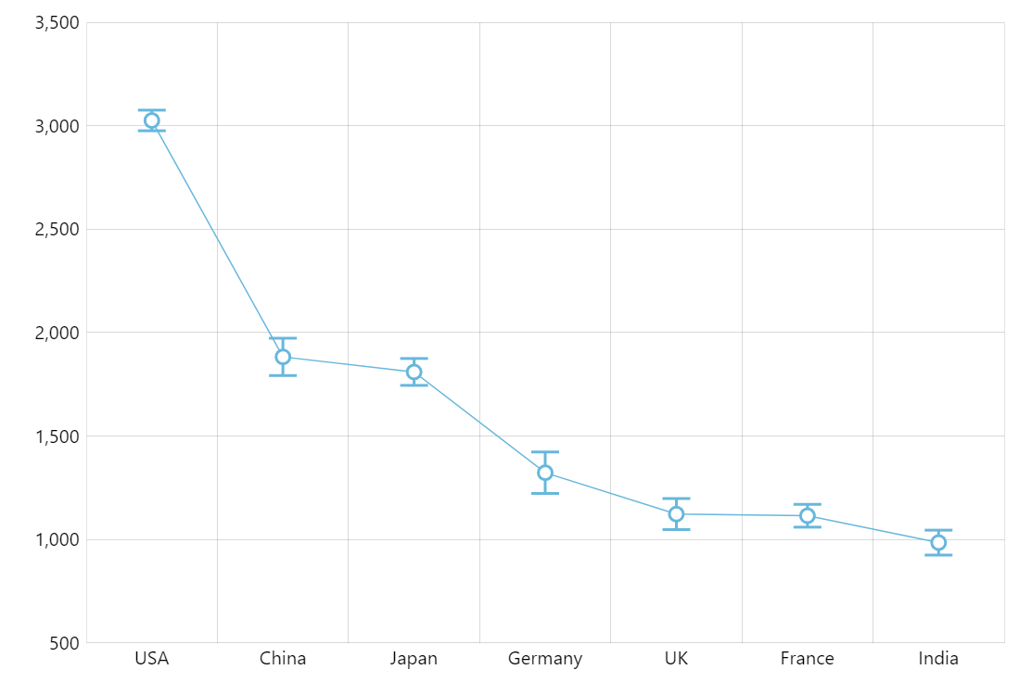
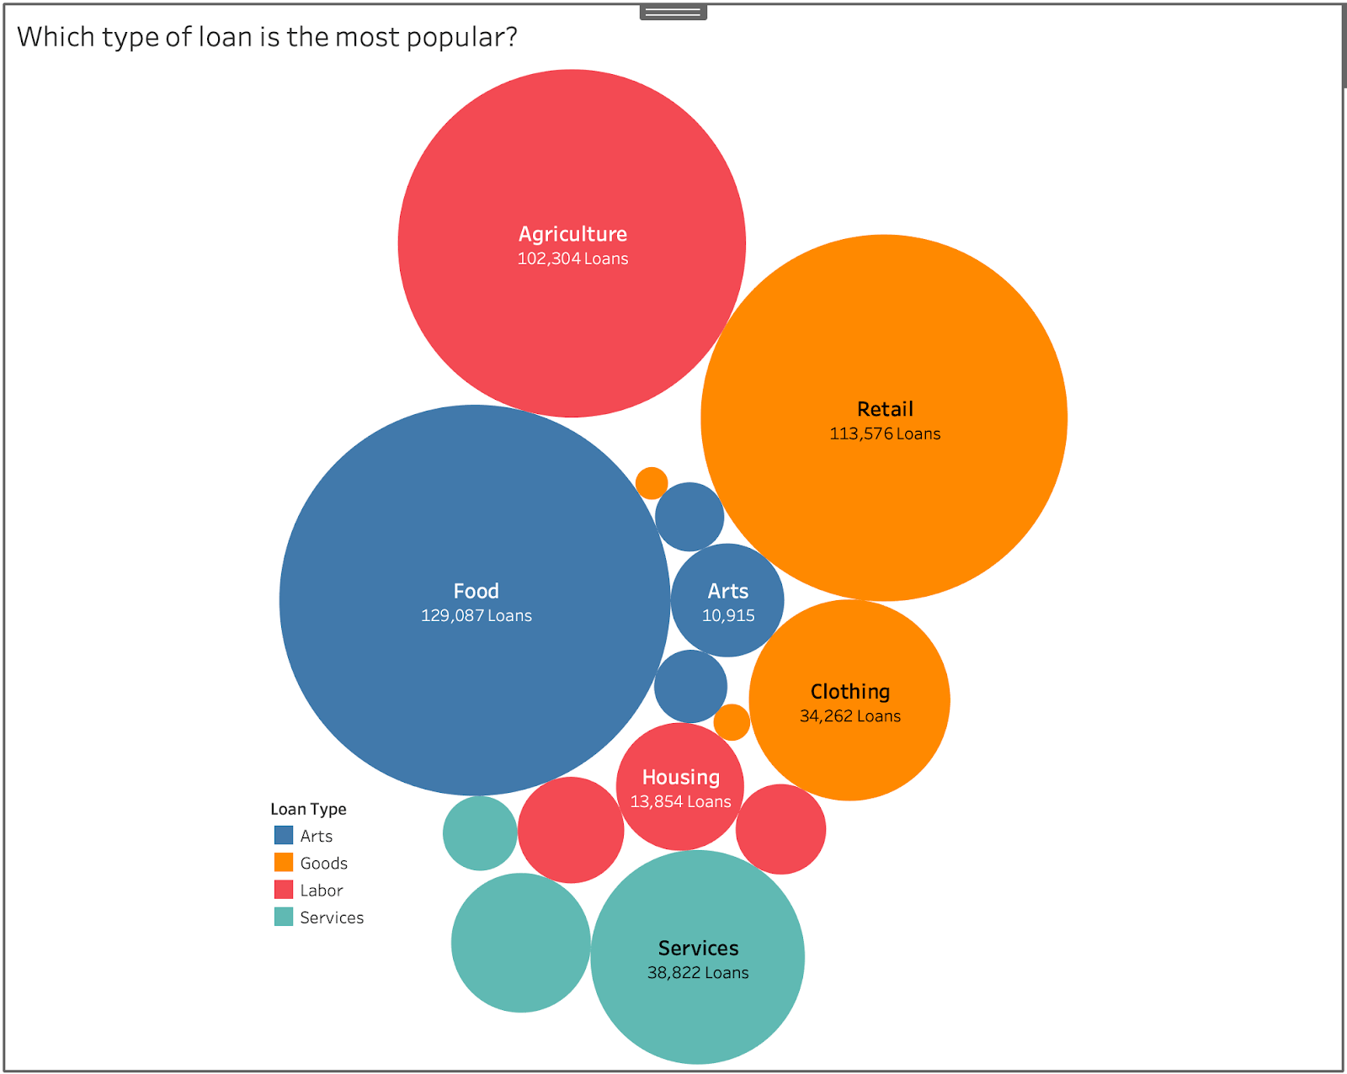
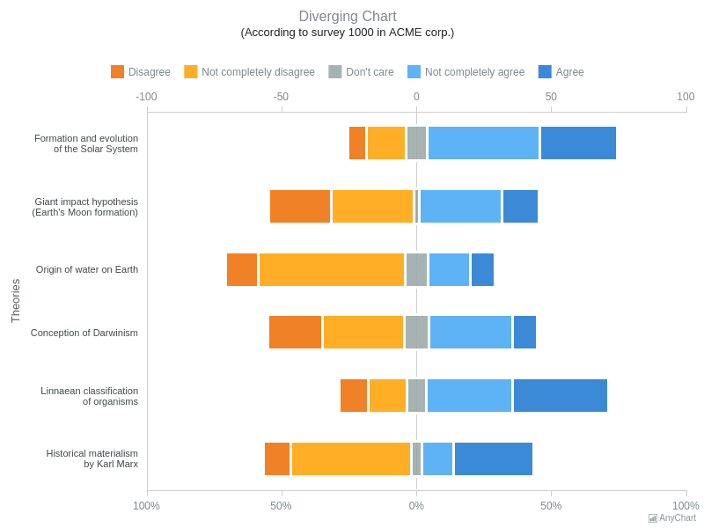
Analyze Data Distribution
Notes:
Bubble and error charts, range charts

Slide 42
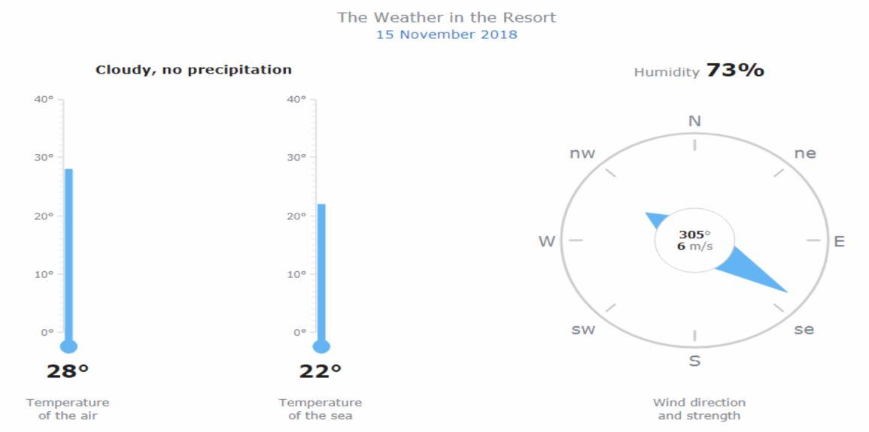
Evaluate Current Performance Data
To evaluate performance and compare the actual value against KPI values or qualitative ranges — and basically, to visualize single-value data as indicators — the following chart types are commonly helpful:
Circular gauges — for a radial scale.
Linear gauges — for a linear scale.
Bullet charts — for a more space-efficient visualization on a linear scale.
For example, you can use circular gauges to visualize speed (like a speedometer) or wind direction (employing a compass-based look); linear gauges — air temperature (thermometer) or tank volume; bullet charts — current vs. planned sales or system availability figures; etc.

Slide 43
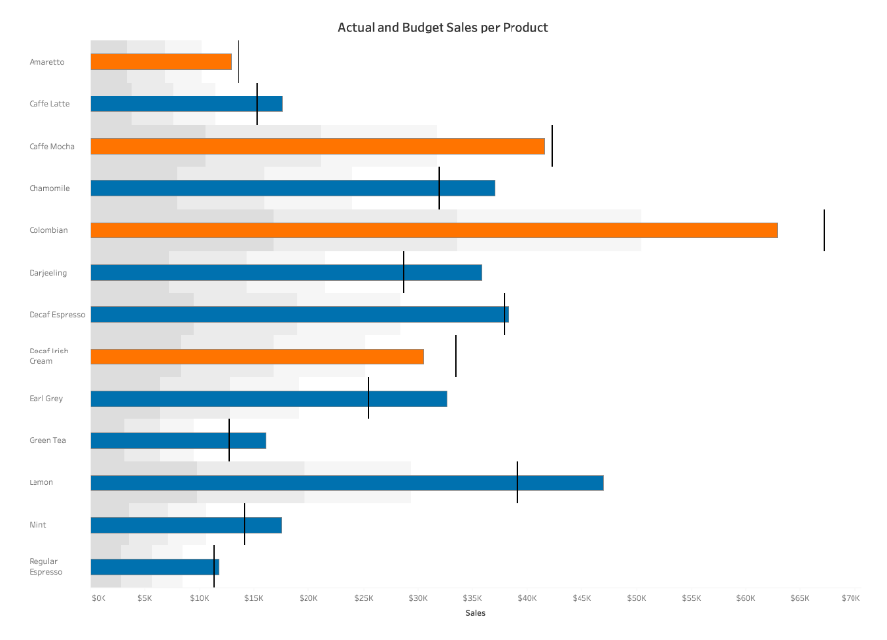
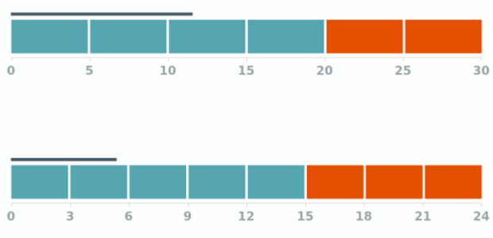
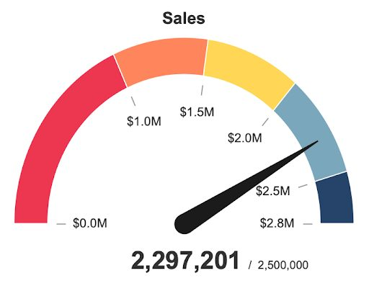
Evaluate Current Performance Data
Notes:
Bullet charts, linear gauges, circular gauges

Slide 44
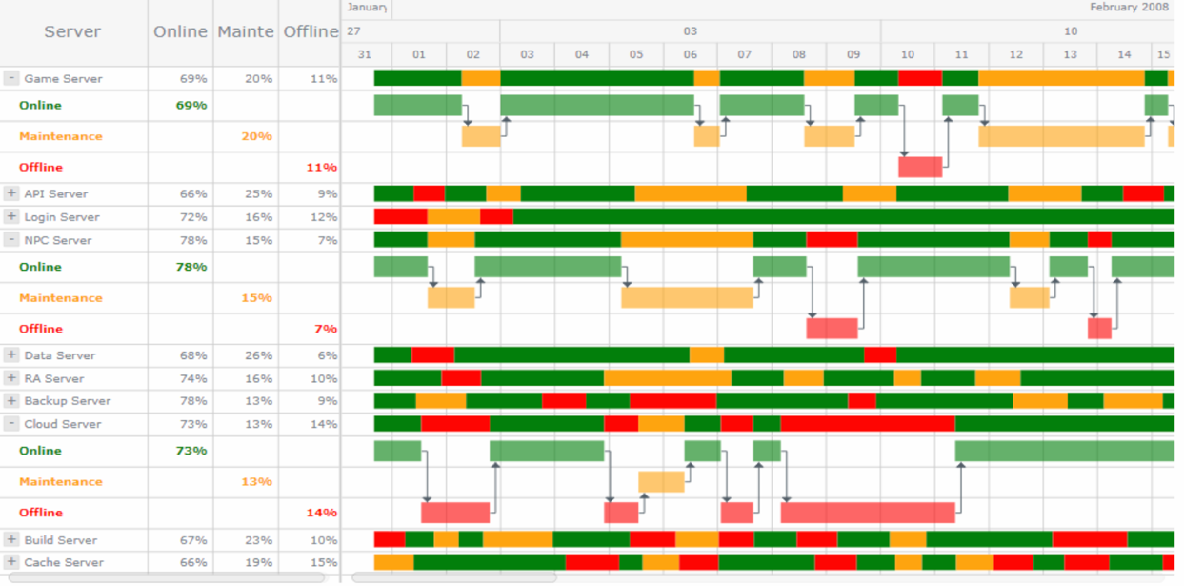
Examine Project Data
To examine project data, the following chart types are commonly helpful:
Gantt chart — to keep an eye on activities on a project schedule.
Resource chart — to review resource occupancy.
For example, you can use Gantt charts to visualize project activities on a schedule or planned vs. actual progress; resource charts — server status; etc

Slide 45
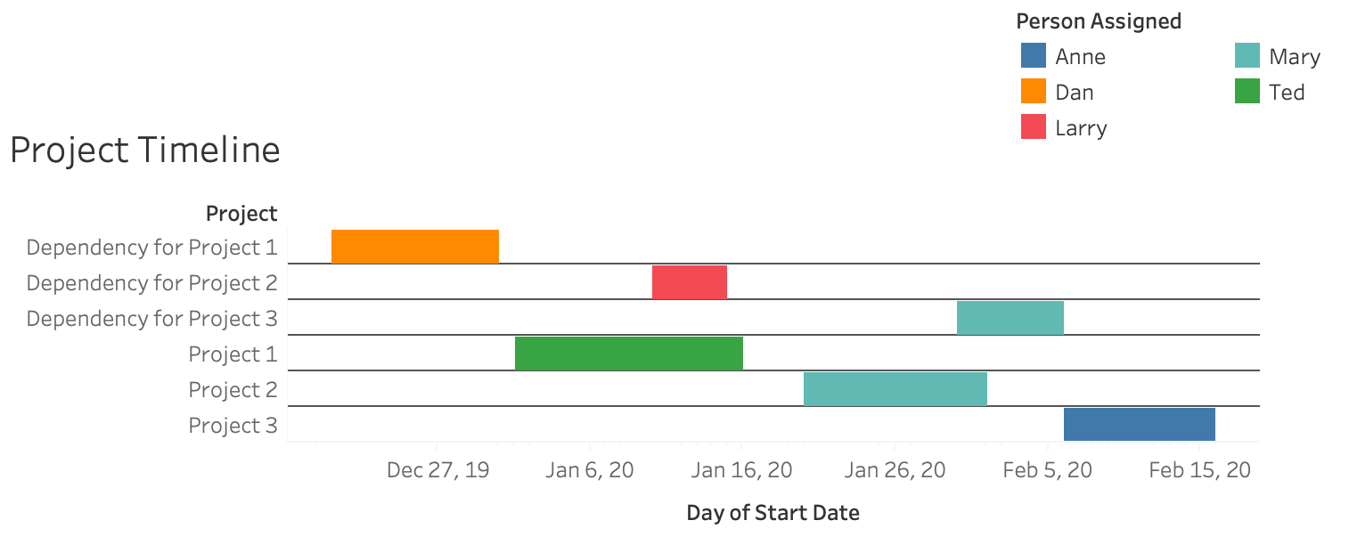
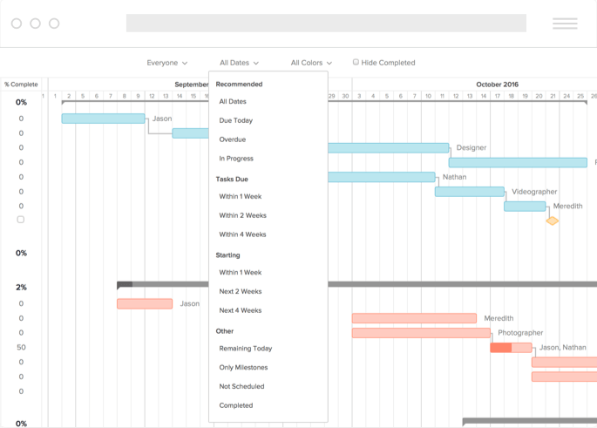
Examine Project Data
Notes:
Gantt chart, resource chart

Slide 46
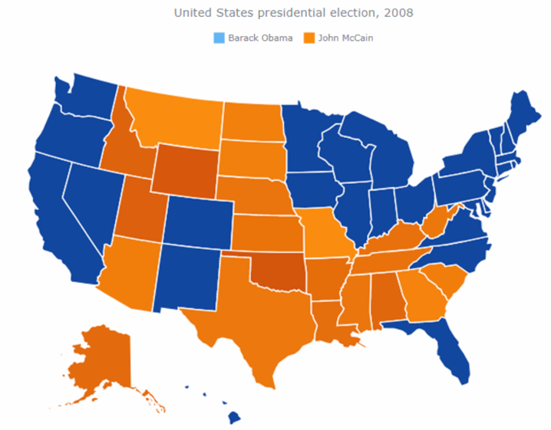
Make Sense of Geographical Data
To make sense of geographical data, the following geo-visualization chart types are commonly helpful:
Choropleth maps — to identify differences across geographical areas.
Dot maps — to understand geographical distribution trends.
Bubble maps — to add a size variable into a visual.
Connector maps — for a look at geographical connections.
Flow maps — to explore how objects move between locations when direction is important.

Slide 47
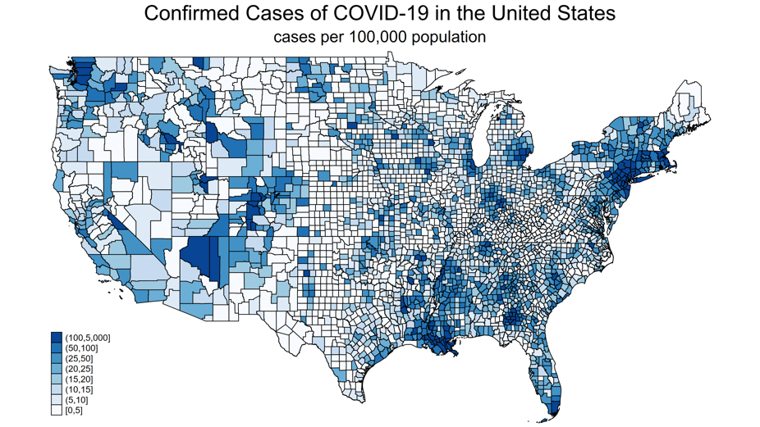
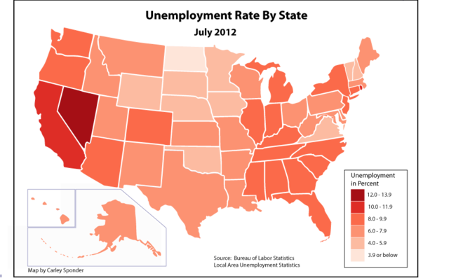
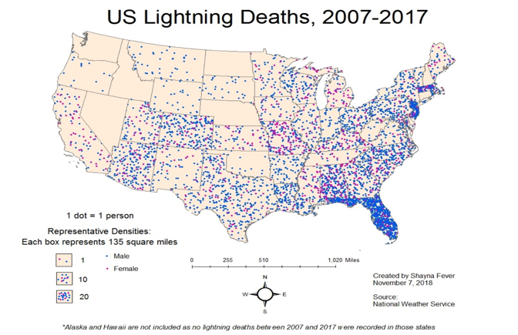
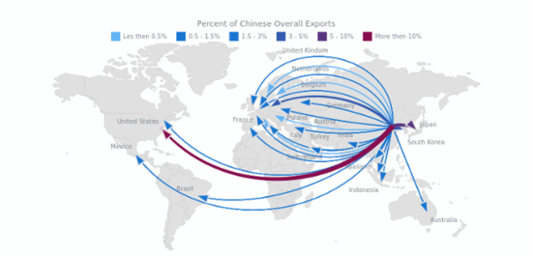
Make Sense of Geographical Data
Notes:
Choropleth map, dot map, flow map

Slide 48
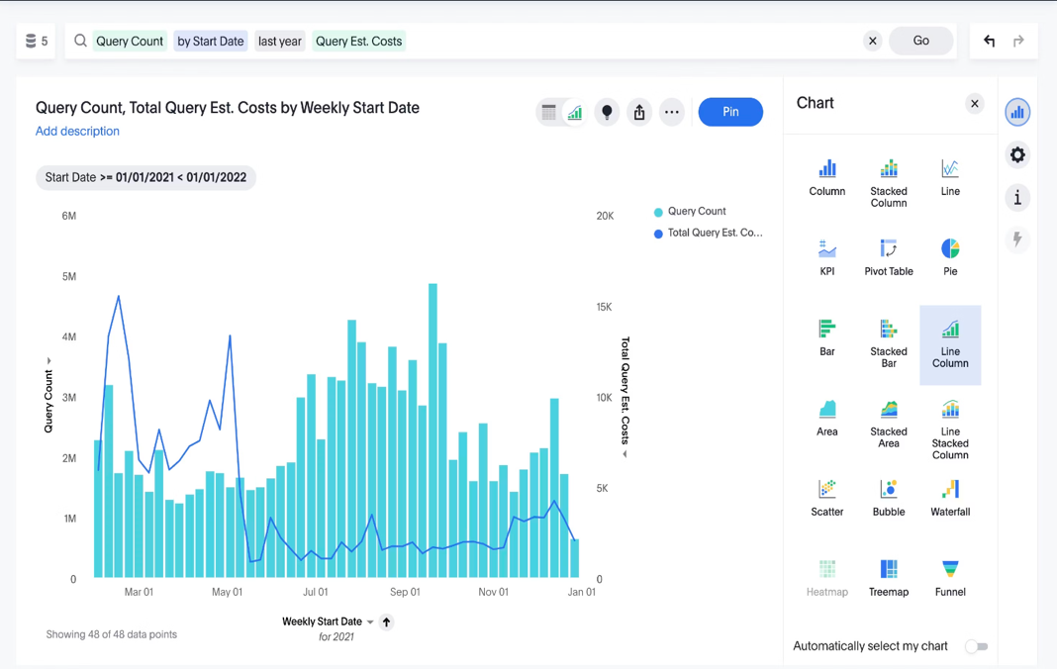
Different types of charts & graphs
Line charts
A line chart connects distinct data points through straight lines. It’s used to find trends, patterns, and variable changes.
When to use line charts?
This type of chart helps measure how different groups relate to each other. This type of chart is also effective for demonstrating progression, making them suitable for scenarios like project timelines, production cycles, or population growth.
Best practices for line charts:
Ensure that the data you're representing has a logical order
Add context through annotations and labels
If the dataset is large, use transparency or spacing to improve visibility

Slide 49
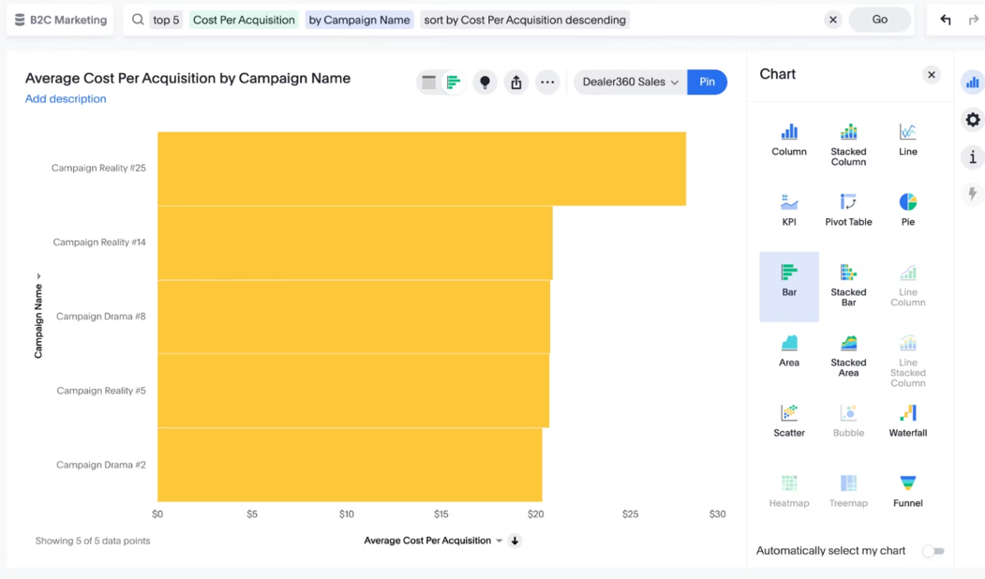
Bar Charts
Bar charts
A bar chart represents data using rectangular bars or columns, the length of each bar corresponds proportionally to its value. You can present these bars horizontally or vertically.
When to use bar charts?
Bar charts are excellent for comparing the values of different categories or groups. They are also helpful in showing distribution of data across different categories.
Best practices for bar charts:
Clearly label each bar and axis with concise labels
Limit the number of bars and categories to avoid cognitive overload
Purposely use colors to highlight key points and convey meaning

Slide 50
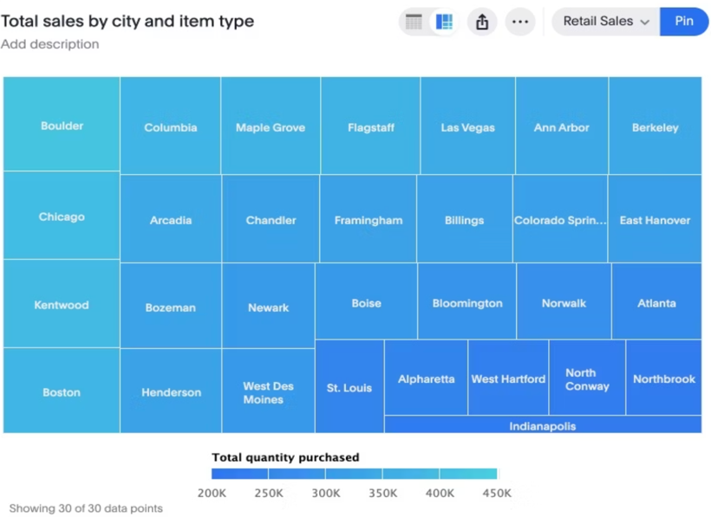
Treemap Charts
Treemap charts
Treemaps are hierarchical charts that allow to visualize data as nested rectangles. These rectangles or branches convey the structure and distribution of data, making treemaps useful for visualizing categorical and hierarchical relationships.
When to use treemap charts?
Apart from visualizing hierarchical data, this type of visualization helps to illustrate part-to-whole relationships within a dataset, demonstrating how each category contributes to the overall composition.
Best practices for treemap charts:
Ensure the size of the rectangle is proportional to the size of the category
Clearly label each rectangle with concise labels
Use a single color with varying shades to show changes in data

Slide 51

Scatter Plots
Scatter plots
Scatter plots are types of visualization that show a collection of data points ‘scattered’ around the graph. The data points can be evenly or unevenly distributed.
When to use scatter plots?
Scatter plots are ideal for exploring relationships and patterns between two continuous variables. They can help you identify trends, correlations, or potential clusters in the data.
Best practices for scatter plots:
Highlight outliers if present in the graph to showcase data distribution
Add a trendline to highlight the relationship between variables
Consider using different colors or marker sizes for overlapping points

Slide 52
Poll Question
Which chart type shows how objects move between locations when direction is important? (single selection)
Tree Maps
Bubble Maps
Dot Maps
Flow Maps

Slide 53

Heatmap Charts
Heatmap charts are a type of map data visualization that uses a system of color coding to represent value.
When to use heatmap charts?
A heatmap is commonly used to establish relationships between two variables across a grid. The intensity of colors demonstrates the variables, making it easy to identify patterns and trends.
Best practices for heatmap charts:
Choose an intuitive color palette that effectively conveys the magnitude of values
Use visual cues to highlight significant values
Utilize the design principle of white space to prevent overcrowding

Slide 54

Pareto Charts
A Pareto chart combines a bar chart and a line graph. The rectangular bars correspond to individual values in descending order, while the line graph displays the cumulative percentage total. This type of chart follows the famous Pareto principle that emphasizes that 20 percent of causes result in 80 percent of problems
When to use Pareto charts?
A Pareto chart effectively showcases the key contributing factors to a particular outcome. Another use case of a Pareto chart is when you want to highlight problems based on their impact.
Best practices for Pareto charts:
Arrange all the categories in descending order based on their frequency, impact, or contribution
Use colors purposefully to enhance clarity

Slide 55

Geo Charts
Geo charts are a type of visualization that represent data on a map. They show spatial information, such as the distribution of values across different regions, countries, or states.
When to use geo charts?
If you want to analyze geographic information in your data, you can use these types of charts to discover hidden patterns and trends. Each region, such as a country, state, or district, is shaded or colored based on the magnitude of the variable presented.
Best practices for geo charts:
Select appropriate map projection that matches your region
Use color shading to highlight particular regions
Label the projections to represent data points on the map

Slide 56

What is Business Intelligence
Business intelligence combines business analytics, data mining, data visualization, data tools and infrastructure, and best practices to help organizations make more data-driven decisions. In practice, you know you’ve got modern business intelligence when you have a comprehensive view of your organization’s data and use that data to drive change, eliminate inefficiencies, and quickly adapt to market or supply changes.
Business intelligence is an infrastructure that helps in the process of collecting, storing, and analyzing data from business operations. BI focuses on descriptive analytics
BI provides comprehensive business metrics, in near-real-time, to support better decision making. You can create performance benchmarks, spot market trends, increase compliance, and improve almost every aspect of your business with better business intelligence
https://www.tableau.com/learn/articles/business-intelligence

Slide 57

TYPES OF ANALYTICS
Descriptive analytics – describes the past status of the domain of interest using a variety of tools through techniques such as reporting, data visualization, dashboards, and scorecards • Predictive analytics – applies statistical and computational methods and models to data regarding past and current events to predict what might happen in the future • Prescriptive analytics –uses results of predictive analytics along with optimization and simulation tools to recommend actions that will lead to a desired outcome

Slide 58

What is business analytics & data analytics
A subset of BI, business analytics (BA) refers to a process of using raw data to find trends and predicting outcomes. Some common methodologies in business analytics are:
Data mining: sorting through large amounts of data to identify patterns and trends
Aggregation: the process of gathering and organizing data prior to analysis
Forecasting: analyzing historical data estimate future outcomes
Predictive modeling: extracting information from data sets to identify patterns and trends
Data visualization: creating visual representations of data analysis, such as charts, tables, or graphs
BA focuses on predictive analytics
Data analytics is a technical process of mining data, cleaning data, transforming data, and building the systems to manage data. Data analytics takes large quantities of data to find trends and solve problems. Data analytics is not just confined to business applications—it’s used across disciplines, from government to science.

Slide 59

How Business Intelligence works
Data – raw material; has volume, velocity, and variety Information – actionable data Operational / transactional systems – places where work is done and raw, siloed data is generated Data integration – the process of aggregating and preparing data from multiple sources to be stored in a warehouse and present a unified view used by BI tools and applications Data warehousing – the storing and/or staging of integrated information, separate from the operational systems, in optimized form for analysis Business intelligence – tools and applications which present and analyze information Big data - could mean really large, could mean unstructured, could mean overly complex, or could mean all of the above
Notes:
The 3 V's (volume, velocity and variety) are three defining properties or dimensions of big data. Volume refers to the amount of data, velocity refers to the speed of data processing, and variety refers to the number of types of data.

Slide 60

How Business Intelligence works
Businesses and organizations have questions and goals. To answer these questions and track performance against these goals, they gather the necessary data, analyze it, and determine which actions to take to reach their goals.
On the technical side, raw data is collected from business systems. Data is processed and then stored in data warehouses, the cloud, applications, and files. Once it’s stored, users can access the data, starting the analysis process to answer business questions.
BI platforms also offer data visualization tools, which convert data into charts or graphs, as well as presenting to any key stakeholders or decision-makers.

Slide 61

Different types of BI methods
Business intelligence has evolved to include more processes and activities to help improve performance. These processes include:
Data mining: Using databases, statistics, and machine learning (ML) to uncover trends in large datasets
Reporting: Sharing data analysis to stakeholders so they can draw conclusions and make decisions
Performance metrics and benchmarking: Comparing current performance data to historical data to track performance against goals, typically using customized dashboards
Descriptive analytics: Using preliminary data analysis to find out what happened
Querying: Asking the data-specific questions, BI pulling the answers from the data sets
Statistical analysis: Taking the results from descriptive analytics and further exploring the data using statistics such as how this trend happened and why
Data visualization: Turning data analysis into visual representations such as charts, graphs, and histograms to more easily consume data
Visual analysis: Exploring data through visual storytelling to communicate insights on the fly and stay in the flow of analysis
Data preparation: Compiling multiple data sources, identifying the dimensions and measurements, and preparing it for data analysis

Slide 62

How BI, data analytics, and business analytics work together
Business intelligence includes data analytics & business analytics and uses them as parts of the whole process.
BI helps users draw conclusions from data analysis. Data scientists dig into the specifics of data, using advanced statistics and predictive analytics to discover patterns and forecast future patterns.
Business analytics includes data mining, predictive analytics, applied analytics, and statistics.” In short, organizations conduct business analytics as part of their larger business intelligence strategy

Slide 63


Traditional BI vs modern BI
Modern BI platforms provide continuous pulse monitoring of the organization through rapid analytics and empower businesses to accomplish mission objectives through predictive analytics.
Modern BI prioritizes self-service analytics and speed to insight. Traditional BI used a top-down approach where BI was managed by IT.

Slide 64


Benefits of BI
Great BI helps businesses and organizations ask and answer questions of their data.
BI is more than just software—it’s a way to keep a holistic and real-time view of all your relevant business data. Implementing BI offers a myriad of benefits, from better analysis to an increase in competitive advantage. Some of the top business intelligence benefits include:
Data clarity
Increased efficiency
Better customer experience
Improved employee satisfaction
Reduced complexity
Trend, insights, patterns & relationships
Improved data access & lower costs
Right time, right data

Slide 65

BI Dashboard
Business intelligence dashboards are information management & data visualization solutions to analyze data.
Content creators can use interactive elements like filters and actions to combine charts, graphs and reports in a single screen for snapshot overviews.
Dashboards are one of the most popular capabilities of BI platforms because they present easily understandable data analysis, allow you to customize which information you want to view, and provide a way to share the results of your analysis with others.
Dashboards and reports are critical for business intelligence, and dashboards can help users understand complex reports. Dashboards are ideal for stakeholders who need at-a-glance overviews of performance. Reports are for stakeholders who need more details and who want to slice and dice data to uncover insights.
Notes:
This interactive dashboard is designed to be used by online retailers and provide them with a high-level to a granular understanding of how different products are performing. It provides an overview of total sales, with the ability to showcase yearly, quarterly, and monthly growth rates. Moreover, it allows anyone to dig through the data and understand the top-performing products, locations, and more.

Slide 66
Poll Question
Business Intelligence focuses on what type of analytics? (single selection)
Descriptive Analytics
Predictive Analytics
Prescriptive Analytics

Slide 67


Claim-Data-Warrants- A Model for Analyzing Arguments
A claim is something the author wants the audience to believe. Data is the evidence or appeal they use to convince the reader to believe the claim. A warrant is the (often implicit) assumption that links the data with the claim.
Stephen Toulmin identifies three essential parts of any argument as the claim; the data (also called grounds or evidence), which support the claim; and the warrant. The warrant is the assumption on which the claim and the evidence depend. Warrant explains why the data support the claim
Notes:
Qualifier: A qualifier is a statement about how strong the claim is. For example, if you are claiming that stains on teeth are caused by drinking coffee, you might need to acknowledge that there may be other causes as well. Your qualified claim would be that drinking coffee is the most significant cause (although perhaps not the only cause) of stained teeth.
Rebuttal: A rebuttal is an exception to your claim. For example, you might have to acknowledge that a certain kind of coffee does not stain teeth. Your claim, however, would be that coffee is the major cause of stained teeth except for those coffee drinkers who drink the special non-teeth staining coffee.
Backing: Sometimes the warrant is an important part of the argument. Additionally, sometimes the warrant is not broadly understood or broadly accepted. In this case, a speaker or writer may have to defend the warrant. In our example, the warrant would need to be backed by reasons such as the argument that whiter teeth will help you get more dates or that whiter teeth will make you look better in yearbook photos. Reasons that support the warrant are called backing.

Slide 68
Data Visualization Redesign – LinkedIn top skills dataset
The objective of this project is to redesign a data visualization (e.g., an infographic, a data visualization in a newspaper, a project report, or a sales report). This will allow you to learn from others, sharpen your critical perspective on data visualizations, reason about design decisions, and attempt to improve data visualizations.
Dataset description:
LinkedIn top skills dataset identifies skills which are in demand based on their respective assigned ranks. The skills are ranked differently in every country and some countries prioritize a certain skill more or less as compared to other nations. The dataset also categorizes the skills on yearly basis and the period from 2014 to 2017 inclusively is used as a framework for analyzing the top skills.
The dataset has four columns Skill, Country, Year and Rank and has over 800 rows of records
The most important objective to prove is the claim that statistical analysis, data analytics and cloud computing are becoming top ranked LinkedIn skills and therefore their demand is increasing. The ranking range used in the dataset is from 1 to 25 where 1 indicates the highest ranked skill.
https://github.com/sultanadeel/Redesign_Project

Slide 69

LinkedIn top skills
Notes:
The above Figure is the existing Tableau visual on the Dataset. It analyzes which LinkedIn skills are in demand among 14 different countries and the percentage of countries having the specific mentioned skill in their top 10 skills. The visual shows beyond doubt that Statistical Analysis and Data Mining is clearly among the top 10 skills of all the countries , proving the fact that Data Analysis is emerging as a very demanding and attractive field both in terms of recruitment as well as for prospective students pursuing educational degrees. The visual also compares the percentage difference in the mentioned skill from 2014 and it shows that almost all Data Mining, Visualization, Cloud computing and virtualization skills are constantly moving up in the ranks and more and more countries are acquiring them in order to grow and prosper economically.

Slide 70

Claim: Top Ranked skills are present in all the major economies as well as the emerging ones
Notes:
Warrant:
The above visual is drawn in Tableau after the data wrangling step in Python. The visual analyzes the distribution of ranks and skills among the countries used in the dataset. For most of the countries in the boxplot, the data is skewed symmetrically as they have a wide dispersion in the distribution of ranked skills . The visual shows that only a few countries have a higher span of lower whisker and a large no. of data points in the 1st quartile range of the boxplot. U.S. is one country where the median of the rank is comparatively low and the data is skewed to the left indicating that the 1st quartile range consists of four different high ranked skills including Statistical Analysis & Data Mining, Cloud & Distributed Computing, and Mobile Development & User Interface Design. U.S. has negative skewness as the lower whisker is skewed to the left indicating that the mean is less than the median. Therefore, average of the ranking distribution is scattered around the top ranks for the U.S. which most has the most popular skills. The above box plot also shows that only a few countries including France, U.S, UAE, China and India have a lower median between the range of ranks 5 to 10, as compared to other countries. This shows that these countries have a greater percentage of top ranked skills possessed or in pursuance by people living in those nations.

Slide 71

Claim: Some technologies become popular simultaneously in all the countries, while other skills emerge from major economies and then spread across the globe
Notes:
Cloud & Distribution has gained popularity as it changed from the rank of 2 in 2014 to 1 in 2016. Despite the fact that Statistical Analysis and Data Mining is overall becoming popular and gaining demand across the globe, in terms of average ranking, the rank has gone down from 1 in 2014 to 2 in 2016. The main reason behind this analogy is that for some developed and major economies from where the top skills actually emerge, such as U.S., U.K. and the other major European countries, the top skills have already passed the most popular stage and are now in later growth stages

Slide 72

Claim: Increasing popularity in top skills is encouraging the previously less popular skills to become more demanding and rewarding
Notes:
One of the most effective ways to visualize changes in ranks over time is to create a bump chart in Tableau as in Fig 1.3 above. This visual shows the changing trends of skill ranks from 2014 to 2016. By hovering the cursor on the circles in the Tableau worksheet, we can see the details such as the skill name and its respective average rank at that particular point in time. The visual shows that from 2014 to 2016, there was a slight variation in the top ranked skills such as Data Mining and Cloud Computing. However, the less popular skills fluctuated a lot, as we see that Pearl/Python/Ruby are becoming popular as the average rank of this skill moved from 10 in 2014 to 6 in 2016. The main reason behind this is that skills like Statistical Analysis and Data Mining and Cloud Computing do require proficiency in data science analysis tools such as Python in order to be well versed in Data Mining. Therefore, Python/Pear/Ruby are climbing up the ranks and becoming more popular over the years.

Slide 73

Claim: Cloud & Statistical Data Mining skills are consistently ranked higher among all the countries as shown by the positive skewness of their respective boxplots
Notes:
The box plot shows that there is a greater degree of variation in the distribution of data for most of the skills. The skills which are most popular in demand in all the countries including Cloud and Distributed Computing and Statistical Analysis and Data Mining have most of the observations concentrated on the low end of the ranking scale indicating the fact that these skills occupy the top ranks . Cloud and Data Mining skills ranking distribution is skewed right and have positive skewness, their range of observations is smaller than the ranges of other skills. Pear/Python/Ruby skill set is also skewed to the right and has positive skewness, however, the range of this skillset is higher as compared to the top 2 skills Cloud and Data Mining, and this is because due to the rising popularity and growing demand of Data Mining and Statistical Analysis tools like Python, its' corresponding demand is also increasing. The positive skewness of Data Mining and Cloud skills also indicate most of the data points are spread out in the lower 1st and 2nd quartile ranges which is clearly shown in the dataset as these skills are on average ranked among the top ranked skills consistently in all the different countries in the dataset.

Slide 74


Deceptive Visualization
The objective of this project is to create a data visualization that purposefully distorts the data or deceives the reader. You start with an existing data visualization and develop a deceptive version of it. You may not alter the data. The purpose of this project is for you to experience and realize the ethical implications of design decisions during the development of data visualizations.
Truncating y-axis in graphs: A very common misleading data visualization example is changing the value of the y-axis’s starting point from zero to any other number. This blows up the differences when comparing data:
Notes:
From the graph left, all data is in the 9300-9800 range on the y-axis and this tends to show an exaggerated growth. This data can be much more accurately presented in the right graph. Now we can see that the differences between the data of the different groups are small. This is a more accurate picture of the differences and a fair way to present the information.

Slide 75


Deceptive Visualization
Improper extraction – Cherry Picking: The graph below (left) is a good misleading data visualization example. This graph shows the average global temperature from 1997 to 2012. The goal of this graph is to prove that global warming is not happening by not looking at the previous data. The chart on the right shows the average temperatures from 1900 to 2020, showing a clear increase in global temperatures.

Slide 76


Deceptive Visualization
Using wrong chart type:
Take into account your stakeholder preferences, expertise levels, and communication styles.
Study the form and function of each chart type.
Ask yourself whether the chart or graph serves a distinct purpose.
Think about what message you want to convey.
Notes:
the pie chart is a poor choice as the visuals don’t represent the numbers in their best or most accurate format. Typically, a pie chart should amount to a whole (100 expressed as a percentage) - but that’s not the case in this instance. As you can see, a neat, balanced bar chart is the best choice as it presents the information in its truest, most digestible form.

Slide 77
Australia Gender Pay Gap
Our main claim is that “Australia’s top 50 jobs pay Men more than Women”. We analyzed that top paying jobs such as Neurosurgery, Ophthalmology and Internal Medicine pay men more than woman even though women are competitively qualified and capable to perform equally well.
Dataset description:
The dataset is provided by the Australian government for over 1,000 related occupations and the respective salaries for Men and Women under each occupation. The occupations are ranked from 1, Neurosurgery being the highest paid profession and 1104 being the lowest paid. The dataset has 5 columns namely, Gender Rank; which ranks every profession differently for Men and Women, Occupation name, Gender, Number of Individuals in each profession, and average taxable Income with the occupation and gender.
This project is aimed at creating two contradictory Tableau Visualizations using a selected dataset on a contentious and debatable topic. Initially, we will develop a visualization that conforms to our main claim and then by incorporating external data in the existing dataset using Python, we will create a rebuttal Tableau visualization that would refute our original claim by providing a legitimate and valid arguments, claims and warrants
https://github.com/sultanadeel/Australia-s_Gender_PayGap

Slide 78

Claim: Male salaries in top professions in Australia are highly dispersed
Notes:
the median of the boxplot for Men is relatively higher than Women and the Men boxplot is skewed to the right and has positive skewness. The outliers for Men boxplot are comparatively greater than for Women boxplot, indicating the fact most of the top occupations are paying Men more than Women in Australia for specific reasons that we would analyze in the rebuttal section of this analysis. We can also see in the boxplot visual that for some high ranked professions like Neurosurgery, there is a wide gap between the Men and Women Average Taxable Income. Men are commanding around $550,000 vs Women only $320,000 for a Neurosurgeon occupation.

Slide 79

Claim: Top Ranked professions pay men more than women in Australia
Notes:
The visual shows that as the rank of occupation gets lower, the Average Taxable Income variation between Men and Women gets narrower. Therefore, the top ranked professions such as Neurosurgery, Ophthalmology, Judge Law, Plastic Surgery and Cardiology are some of the professions which pay Men significantly more than Women.

Slide 80

Claim: Australia's top 50 jobs pay Men significantly more than Women
Notes:
The DNA chart is an accurate reflection of this claim, it represents the actual difference or spread between the two quantities which are the Average Taxable Income of Men and Women represented by blue and yellow colors respectively. The line between any two points shows the difference in the salary range for any particular occupation. We can see that the biggest difference is in the top ranked profession of Neurosurgery, Ophthalmology, Orthopedic Surgery and Cardiology. The bigger the difference in the two quantities in the DNA chart, the more persuasive our claim would be that the top ranked jobs are paying Men more than Women. DNA chart clearly supports our claim and is a persuasive and easy to understand visualization made using the existing dataset on Australian Gender gap in salaries

Slide 81

Rebuttal to the original claim: Full Time Labor force participation of Women is less than Men in Australia
Notes:
After incorporating external data from http://www.oecd.org/gender/data/employment/ on Australia’s total and full time labor force participation by Men and Women, we analyzed that Women’s participation in full time labor force in Australia is significantly less than Men and stands at 53.3% against 81.4% for Men in the year 2016
Therefore, our Rebuttal claim which contradicts and refutes our original claim that “Australia’s Top 50 jobs pay Men significantly more than Women” is that “Since Women’s participation in Australia’s Full time labor force is significantly less than Men, the Average Taxable Income of Women is less than Men”.
Since women are less actively involved in the full time employment, their Average taxable Income is lesser than Men who are able to work full time more often than Women and thus able to command higher income than Women because of greater full time availability. This analogy is focused more on the top 50 occupations including Neurosurgery and Medicine related occupations where full time availability is of utmost importance and of higher demand by the employer considering the risk involved in the occupation

Slide 82

Rebuttal to the original claim: Full Time Labor force participation of Women is less than Men in Australia
https://www.ussc.edu.au/analysis/women-at-work-australia-and-the-united-states
Notes:
The above image which is used for explanatory purposes from the source mentioned above, indicates the proportion of Women and Men working full time and part time in Australia, it shows that 61.7% of Women work full time compared to 86% of Men working full time

Slide 83

Investing in cryptocurrencies
Our targeted audience is a potential investor interested in diversifying his/her existing portfolio of investments. In order to maximize expected return and minimize foreseeable risk ,the ultimate objective is to invest in a industry different than the existing ones, and we are analyzing the positive and negative aspects of investing in cryptocurrencies, specifically Bitcoin
Audience Need:
The Audience is interested in taking profits from the likely arbitrage opportunity embedded in cryptocurrencies. As we see in the patterns and trends of cryptocurrencies historical prices, there are short-term spikes and upticks in the prices which has profit making opportunity for prospective investors.
Audience Want:
Our audience for this analysis of Bitcoin investment is a prospective investor intending to diversify investments.
Audience Fears:
Cryptocurrencies are not backed by any government or a regulatory agency and the operations are decentralized as compared to the traditional centralized banking system and financial markets. Therefore, a general perception and an expected fear of our audience would be the safety, reliability and foreseeability of their investment in cryptocurrencies
https://github.com/sultanadeel/Team-project---The-Bitcoin

Slide 84


Candlestick Charts
A candlestick chart is a style of financial chart used to describe price movements of a security, derivative, or currency.
While similar in appearance to a bar chart, each candlestick represents four important pieces of information for that day: open and close in the thick body, and high and low in the "candle wick". Being densely packed with information, it tends to represent trading patterns over short periods of time, often a few days or a few trading sessions
Candlestick charts also used for iot sensor data or timeseries data
Candlestick Components
Just like a bar chart, a daily candlestick shows the market's open, high, low, and close prices for the day. The candlestick has a wide part called the "real body."
This real body represents the price range between the open and close of that day's trading. When the real body is filled in or black (also red), it means the close was lower than the open. If the real body is white (or green), it means the close was higher than the open.

Slide 85

Bitcoin vs Ethereum
Notes:
A candlestick chart is a style of financial chart used to describe price movements of a security, derivative, or currency.
While similar in appearance to a bar chart, each candlestick represents four important pieces of information for that day: open and close in the thick body, and high and low in the "candle wick". Being densely packed with information, it tends to represent trading patterns over short periods of time, often a few days or a few trading sessions
Bitcoin has witnessed a tremendous increase in its market price since inception and has remained the least volatile cryptocurrency in terms of investment and the price appreciation over the recent years when compared to Ethereum, which had a wide volatility rate in 2017

Slide 86


Bollinger Bands
Bollinger Bands, a popular tool among investors and traders, helps gauge the volatility of stocks and other securities to determine if they are over- or undervalued.
Bollinger Bands is a technical analysis tool used to determine where prices are high and low
These bands are composed of 3 lines: simple moving average (the middle band) and an upper and lower band.
The upper and lower bands are typically two standard deviations above or below a 20-period simple moving average (SMA).
The bands widen and narrow as the volatility of the underlying asset changes.
Notes:
When the bands tighten during a period of low volatility, it raises the likelihood of a sharp price move in either direction. This may begin a trending move. Watch out for a false move in opposite direction which reverses before the proper trend begins.When the bands separate by an unusual large amount, volatility increases and any existing trend may be ending.

Slide 87



Bollinger bands to compare volatility
Notes:
Bitcoin has witnessed a steady rise and its moving average has reasonably stayed with the lower and upper bands. This indicates less volatility and better foreseeability for prospective investors interested in investing in Bitcoin while for Ethereum, since upper and lower bands indicate volatility, we can see that it has suffered a drastic volatility in 2017 as the bands widened in the gap from the moving average in the middle. Though this trend was witnessed by almost all of the major cryptocurrencies in the year 2017 but volatility of Ethereum was higher than that of Bitcoin. The reason being, Ethereum is an altcoin which makes it more prone to pump and dump behavior and less likely to be considered a long term asset. So, Ethereum being new to market is experiencing high supply ans people can move it around faster because of its low fees and block times. Litecoin also has high volatility as compared to bitcoin, as there is more gap in upper and lower bands.

Slide 88

Python data visualization
Python provides various libraries that come with different features for visualizing data. All these libraries come with different features and can support various types of graphs
Matplotlib
Matplotlib is an easy-to-use, low-level data visualization library that is built on NumPy arrays. It consists of various plots like scatter plot, line plot, histogram, etc. Matplotlib provides a lot of flexibility.
Seaborn
Seaborn is a high-level interface built on top of the Matplotlib. It provides beautiful design styles and color palettes to make more attractive graphs.
Bokeh
Bokeh is mainly famous for its interactive charts visualization. Bokeh renders its plots using HTML and JavaScript that uses modern web browsers for presenting elegant, concise construction of novel graphics with high-level interactivity.
Plotly
Plotly has hover tool capabilities that allow to detect any outliers or anomalies in numerous data points.
It allows more customization. It makes the graph visually more attractive.

Slide 89



Plotly Dash
Dash is Python framework for building web applications. It built on top of Flask, Plotly.js, React and React Js. It enables you to build dashboards using pure Python. Dash is open source, and its apps run on the web browser
A Dash application is usually composed of two parts. The first part is the layout and describes how the app will look like and the second part describes the interactivity of the application. Dash provides HTML classes that enable us to generate HTML content with Python.
Dash is the most downloaded, trusted Python framework for building ML & data science web apps.
https://github.com/plotly/dash?tab=readme-ov-file
Notes:
Here’s a simple example of a Dash App that ties a Dropdown to a Plotly Graph. As the user selects a value in the Dropdown, the application code dynamically exports data from Google Finance into a Pandas DataFrame. This app was written in just 43 lines of code
Dash app code is declarative and reactive, which makes it easy to build complex apps that contain many interactive elements. Here’s an example with 5 inputs, 3 outputs, and cross filtering. This app was composed in just 160 lines of code, all of which were Python.

Slide 90



Plotly Dash
Notes:
Dash isn't just for dashboards. You have full control over the look and feel of your applications. Here's a Dash App that's styled to look like a PDF report.

Slide 91



Plotly Dash

Slide 92

New York Uber Rides
https://dash.gallery/dash-uber-rides-demo/

Slide 93


Support Vector Machines Explorer
Dash is the most downloaded, trusted framework for building machine learning web apps in Python.
https://dash.gallery/dashr-svm/
Notes:
ML-dash replaces visdom and tensorboard. It allows you to see real-time updates, review 1000+ of experiments quickly, and dive in-depth into individual experiments with minimum mental effort.

Slide 94



Data Visualization tools

Slide 95

Data Visualization Trends
Notes:
Data visualization has emerged as an indispensable tool for transforming raw data into meaningful and insightful representations. As the volume and complexity of data continue to grow exponentially, effective data visualization techniques have become essential for extracting knowledge, identifying patterns, and communicating insights to a wider audience.

Slide 96
Conclusion
Data visualization has emerged as an indispensable tool for transforming raw data into meaningful and insightful representations. As the volume and complexity of data continue to grow exponentially, effective data visualization techniques have become essential for extracting knowledge, identifying patterns, and communicating insights to a wider audience.

Slide 97
References
https://spectrum.adobe.com/page/data-visualization-fundamentals/
https://www.thoughtspot.com/data-trends/data-visualization/data-visualization-principles
https://www.effectivedatastorytelling.com/post/a-data-storytellers-guide-to-avoiding-clutter
https://www.anychart.com/blog/2018/11/20/data-visualization-definition-history-examples/
https://www.thoughtspot.com/data-trends/data-visualization/types-of-charts-graphs
https://www.tableau.com/learn/articles/business-intelligence/bi-business-analytics
https://www.dreamstime.com/seven-benefits-business-intelligence-image148961805
https://www.scribbr.com/frequently-asked-questions/claims-supports-warrants/
https://dash.plotly.com/layout
https://github.com/plotly/dash?tab=readme-ov-file
https://medium.com/@mokkup/the-future-of-data-visualization-2024-and-beyond-3173a8e60494

